Slide 1



Unit 4
Machine Learning

Slide 2
Chapters for Discussion
Chapter - 1
Dimensionality Reduction Techniques (PCA)
Chapter - 2
DBSCAN
Chapter - 3
Ensemble Machine learning models

Slide 3

Chapter 3
Ensemble Machine learning models

Slide 4
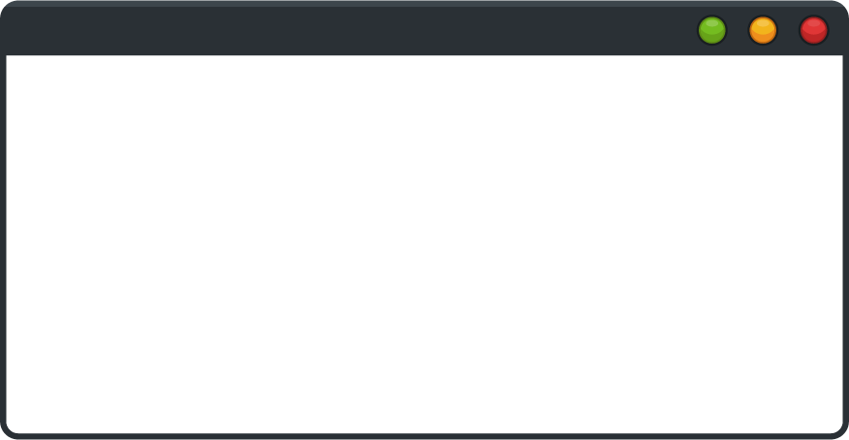

DISCLAIMER
The content is curated from online/offline resources and used for educational purpose only.

Slide 5

Learning Objectives
Ensemble Learning
Understand concept of Bagging , Boosting and Stacking
Implementation of Random Forest using Sklearn
GOAL

Slide 6
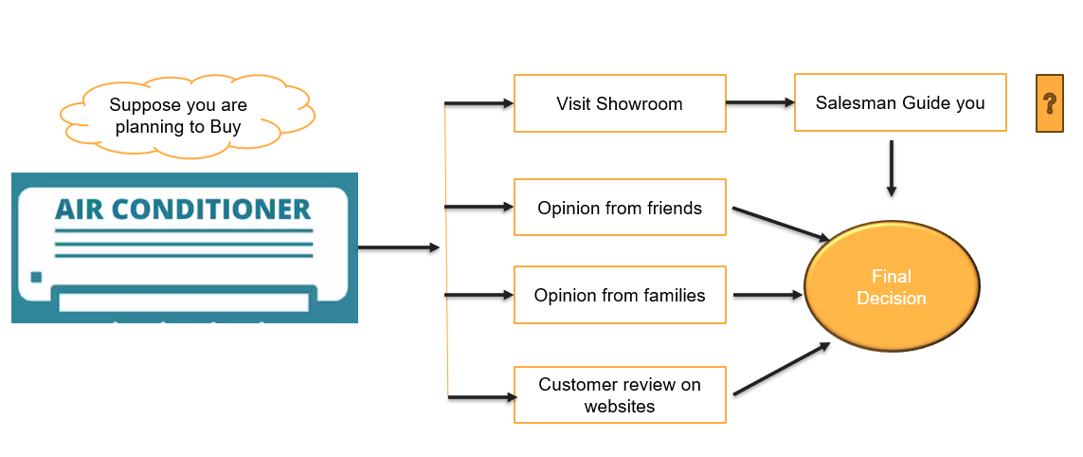

Slide 7

Introduction of Ensemble Machine Learning
Literary meaning of the word ‘ensemble’ is group.
These methods involve a group of predictive models.
Achieve better accuracy and model stability.
Noise, variance and bias are the major sources of error.
Ensemble learning is one way to tackle bias-variance trade-off.
Reference

Slide 8
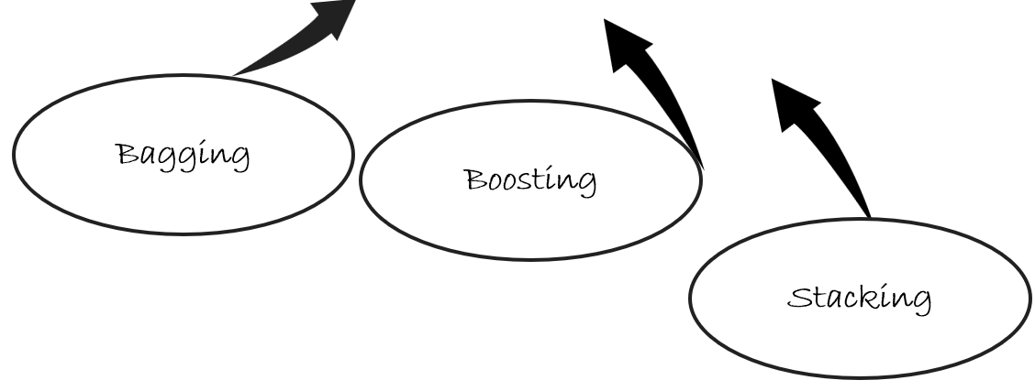
Types of Ensemble Learning
There are various ways to ensemble weak learners to come up with strong learners:

Slide 9
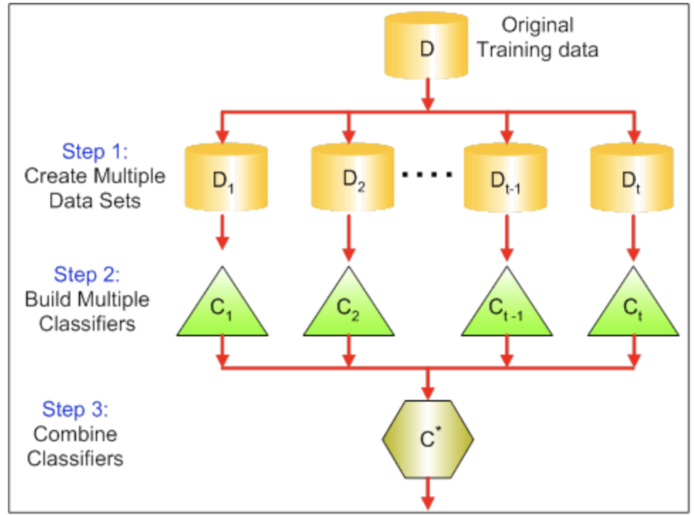
Bagging
An ensemble technique used to reduce the variance
Combines the result of multiple classifiers modeled on different sub-samples of the same data set.
Example- Random Forest
Reference
Notes:
Each model in the bagging ensemble is trained on a slightly different dataset, so it may make slightly different predictions. Aggregating them reduces the overall variance, leading to more robust predictions.
Aggregation: The predictions from all the models are averaged (or the most common prediction is selected in the case of classification) to produce a final prediction.
Example weather forcasting

Slide 10
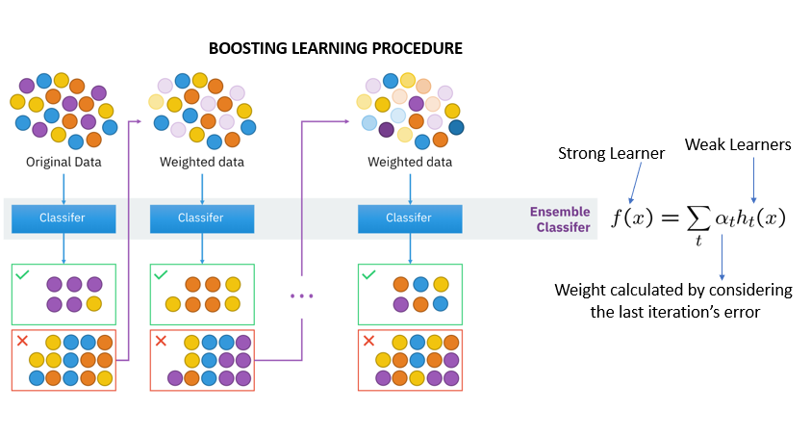
Boosting
Boosting fit a sequence of weak learners.
Include models that are only slightly better than random guessing
More weight is given to examples that were misclassified by earlier rounds
Prominent Boosting techniques:
Gradient Boosting Machine
XGBoost
AdaBoost
LightGBM
CatBoost
Reference
Notes:
Boosting works by building models in sequence, with each new model trying to fix the mistakes made by the previous ones. In the case of spam detection, this approach helps the system learn from misclassifications and improve the overall accuracy of detecting spam emails. Boosting reduces both bias and variance, but it can be prone to overfitting if not properly controlled.
Example – Email spam classification

Slide 11
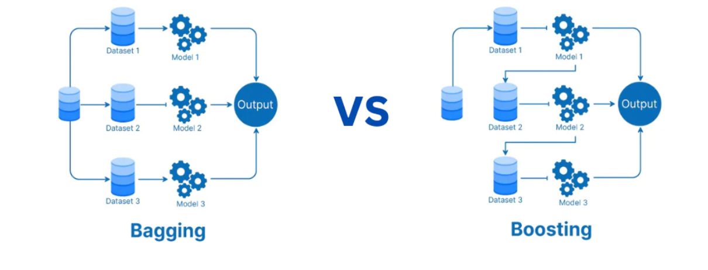
Bagging vs. Boosting
Source :
Reference
Notes:
Trainer have to differentiate Bagging and Boosting:
Bagging is a type of parallel ensemble learning. Because multiple model trained simultaneously on different subset of training data. In the figure you can see that three different models are trained on three sub dataset simultaneously.
On the other hand , boosting is a type of sequential ensemble learning. Here ,instead of parallel processing of data, sequential processing of the dataset occurs. The model 1 is fed with the entire dataset, and the predictions are analysed.
The data points where model 1 fails to produce correct predictions are fed to the model 2.
Same process repeated again in Boosting.

Slide 12
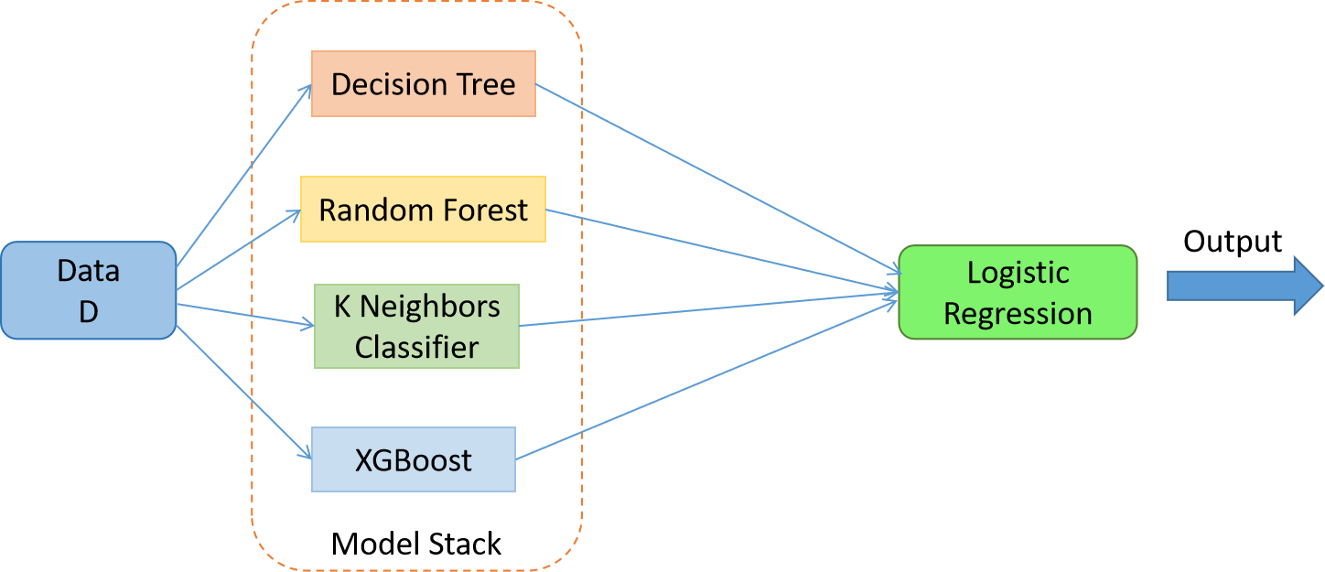
Stacking
Stacking: an ensemble technique.
Uses a meta-learning algorithm to learn.
Best combine the predictions from two or more base machine learning algorithms.
In stacking, a single model is used to learn how to best combine the predictions from the contributing models (e.g. instead of a sequence of models that correct the predictions of prior models).
Reference
Notes:
In stacking, the base models (collaborative filtering, content-based filtering, deep learning) make independent predictions, and the meta-model learns how to combine them for better overall recommendations. This approach allows the system to leverage the strengths of different models and provides more accurate, personalized movie suggestions.
Why Stacking Works in This Scenario:
Each model might capture different patterns in user behavior, and stacking allows the system to take the best of each model's predictions to make more accurate recommendations. The meta-model improves the overall performance by determining which base model is best for a particular situation, user, or movie.
Example movie recommendation

Slide 13

Random Forest
As in bagging, we build a number of decision trees on bootstrapped training samples.
Each time a split in a tree is considered.
A random sample of m predictors is chosen as split candidates from the full set of p predictors.
Note that if m = p, then this is bagging.
Source :
Reference
Notes:
Random Forest:
A Random Forest Algorithm is a supervised machine learning algorithm that is extremely popular and is used for Classification and Regression problems in Machine Learning.
A Random Forest algorithm is based on Bagging technique.
Random forest builds forest of multiple decision trees and merges them together to get a more accurate and stable prediction.

Slide 14

Random Forest Algorithm
Chooses a random sample/random subset from the entire data set.
Each model is generated from the samples (Bootstrap Samples) provided by the Original Data with replacement.
This step of row sampling with replacement is called bootstrap.
Each model is trained independently, which generates results.
To make a prediction at a new point x we do:
For regression: average the results
For classification: majority vote
Source :
Reference
Notes:
Trainer can explain working of Random Forest with simple example:
Suppose we have training dataset D.
Choose random samples / random subset from entire dataset D. This is known das Bootstrap Sampling. In the given figure we have N sub dataset.
For Each subset , random forest will build decision tree. In the given figure N Decision trees like Decision Tree-1, Decision Tree-2 , Decision Tree-N are trained on different data subset.
Each Decision tree generates result independently.
Final result will be generated on the basis of Majority voting or Average result.

Slide 15
Random Forests Tuning
Suggested recommendations:
For classification, the default value for m is √p and the minimum node size is one.
For regression, the default value for m is p/3 and the minimum node size is five.
In practice the best values for these parameters will depend on the problem, and they should be treated as tuning parameters.
Like with Bagging, we can use OOB(Out-of-Bag) therefore, RF can be fit in one sequence, with cross-validation being performed along the way.
Once the OOB error stabilizes, the training can be terminated
Notes:
Trainer can share some recommendation regarding Random Forest Tuning.
In the random forest algorithm in machine learning, hyperparameters are used to either speed up the model or improve its performance and predictive ability.
The best value of m depends on the problem, so m should be treated as a tuning parameter.

Slide 16
Random Forests Issues
When the number of variables is large, but the fraction of relevant variables is small, random forests are likely to perform poorly when m is small , Why?
Because At each split the chance can be small that the relevant variables will be selected
For example, with 3 relevant and 100 not so relevant variables the probability of any of the relevant variables being selected at any split is ~0.25
Random forests “cannot overfit” the data with respect to number of trees. Why?
The number of trees, does not mean increase in the flexibility of the model
Notes:
Random Forest Issues:
When the number of relevant features is very less in large variable dataset, then random forest algorithm perform very poor.
Because chances of selection of relevant variable at every split is very less.
The second issue with random forest is that a large number of trees can make the algorithm too slow and ineffective for real-time predictions.

Slide 17

Lab Activity
Hands On
Lab 1
Demonstrating Random Forest Algorithm
Notes:
Hello Students let’s pace into the realization of Random Forest Algorithm for a general case.
GitHub link: - Module-1/Unit-2/2.6/Lab 1 - Classroom Exercise_Random_Forest_Demo.ipynb

Slide 18


Let’s Start

Slide 19


Quiz
Ensemble learning is a machine learning technique that involves:
Training multiple models and combining their predictions
Training a single model on a large dataset
Training a model using a deep neural network
Training a model using reinforcement learning
Answer: A
Training multiple models and combining their predictions

Slide 20
Quiz
2. Which of the following is an example of an ensemble learning algorithm?
Decision Tree
Support Vector Machine (SVM)
Random Forest
K-Nearest Neighbors (KNN)
Answer: C
Random Forest

Slide 21
Quiz
3. Which ensemble learning algorithm assigns weights to base models based on their performance?
AdaBoost
Random Forest
Gradient Boosting
Stacking
Answer: A
AdaBoost

Slide 22
Thank You
Notes:
Thank You !!

